Slide 1
Inventory Management in Services
Chapter 13

Slide 2
Service Industries Affected
Retail
  Grocers
  Department Stores
  Clothing/Toys/Building Supplies/etc.
Wholesalers
Military
  Soldier’s pack contents
  Tank contents
Repair Services (Field Service)
  Kit management
  Repair facilities
1

Slide 3
Differences from Manufacturing
Low setup costs
Large number of SKU's
Demand variance/mean ratio larger in services
Constraints on number of SKU's
Perishability - food items, seasonal goods
Product substitutability
Information accuracy
2

Slide 4
Business Environment Changes
Technology
Logistics
Inventory policies have not kept up

Slide 5
Example 13.1: The Newsstand
Buy papers for $0.30, sell for $0.50
C_{o} = the cost of “overage” = $0.30
C_{s} = the cost of “stocking out” =
$0.50-$0.30=$0.20

Slide 6
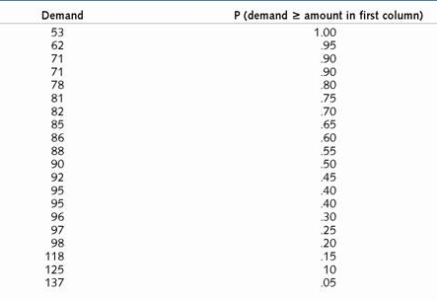
Newsstand Example
Mean Demand = 90
Standard Deviation = 20

Slide 7
Marginal Analysis of the Newsstand
increase inventory until:
E(revenue of next unit of inventory) <=
E(cost of next unit of inventory)
Equation 13.1: C_{o} /(C_{s} + C_{o}) <= P(d >= y)
$0.30/$0.50= 0.60 <= P(d >= y), so order 86
Demand (from lowest to highest) P(demand >= amount in first column)
82 .70
85 .65
86 .60
88 .55
90 .50

Slide 8
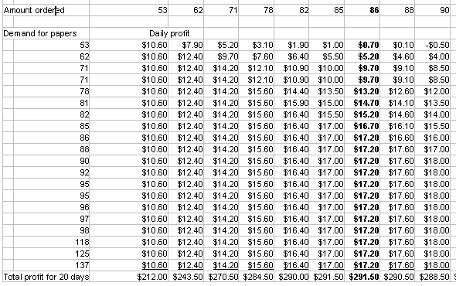
Marginal Analysis of the Newsstand

Slide 9
Typical Retail Product Inventory
Product sells for $10, weekly delivery
C_{s} = $6.
C_{o} = $10 x 0.25/52 = $0.05
C_{o} /(C_{s} + C_{o}) = 0.008
Stock to 1.00-0.008= 99.2%
Asymmetric penalties force stocking levels even higher

Slide 10
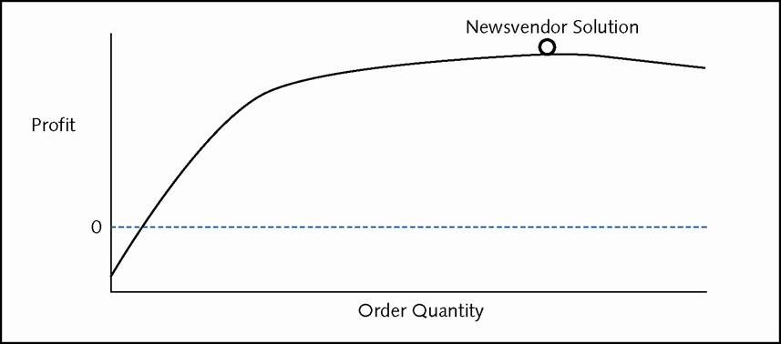
Profit Curve for Typical Service Inventory Item

Slide 11
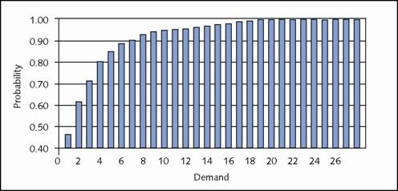
Negative Binomial Distribution
(mean = 2, variance = 10)

Slide 12
Stocking Multiple Products
Weeks of Demand or “The Gut Feel” Approach
Using intuition regarding uncertainty
  Provide high service for items with less variance
  Provide lower service for items with high variance
Using intuition regarding cost
  Provide high service for less costly items
  Provide lower service for more costly items

Slide 13
Fill Rate Vs. Percent of Cycles with Stock-outs
Important to customers: Fill Rate
Typically calculated: Percent of Cycles
Percent of Cycles with Stock-outs Calculation
Calculating EOQ and Re-order Point
Q = Sqrt(2xDemandxSetup cost/Holding cost)
Re-order Point = Demand Lead Time +
z x Standard Deviation of Demand Lead Time
5

Slide 14
Fill Rate Calculation
20% of days demand is 90
60% of days demand is 100
20% of days demand is 110
Stock = 90
Fill rate (.2x90 + .6x90 + .2x90)/(.2x90 + .6x100 +.2x110) = 90%
Stock = 100
Fill rate (.2x90 + .6x100 + .2x100)/(.2x90 + .6x100 +.2x110) = 98%
6

Slide 15
Cycle Service Vs. Fill Rate
Inventory 90 100 110
Percent cycles with
no stockout 20% 80% 100%
Fill rate 90% 98% 100%

Slide 16
Methods to Stock Products
Method 1: Weeks of Sales or “The Gut Feel” Approach
Method 2: Constant “K” Solution or The “Faulty Assumptions” Approach
Method 3: Constant Service Solution or The “Logical but Not So Simple” Approach
Method 4: Optimal Solution – Marginal Analysis

Slide 17
Effect of Differential Demand Variance on stocking methods
Example: 3 items in inventory
  item PyZen is Poisson distributed, mean demand 9, variance 9
  item Nega-Byno-meal is Negative Binomial distributed, mean demand 9, variance 81
  item Byno-meal is Binomial distributed, mean demand 9, variance 4
Desire a 95% service level (fill rate).
  How much do you stock?
9

Slide 18
Method 1: Weeks of Sales Approach
Stock two weeks worth of demand, or 18, for each product

Slide 19
Method 2: Constant “K” Solution
K=1.65 (as 1.65 is the “K” factor associated with 95% service) x standard deviation of demand units of safety stock in addition to mean demand.
For this specific case, the calculations are:
Byno-Meal: 9 + 1.65 x 2 = 12,
PyZen: 9 + 1.65 x 3 = 14,
Nega-Byno-Meal: 9 + 1.65 x 9 = 24.

Slide 20
Method 3: Constant Service Solution
If 95% service is desired in the entire store, then achieve 95% service in each and every product
Stock:
10 Byno-Meal
11 PyZen
27 Byno-Meal
Where do these numbers come from?

Slide 21
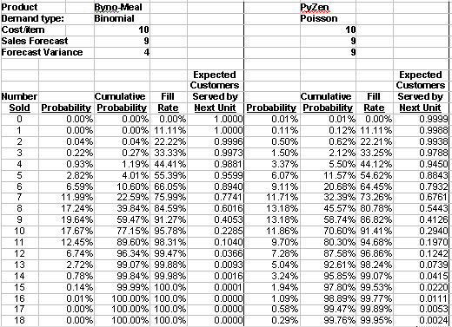
Method 3: Constant Service Solution
Notes:
From previous slide, stock 10 Byno-Meal and 11 PyZen

Slide 22
Method 4: Optimal Solution – Marginal Analysis
Stock:
12 Byno-Meal
13 PyZen
19 Byno-Meal
Where do these numbers come from?

Slide 23
Marginal Analysis
Iteratively assign inventory to products. Where to assign 1st unit?
Item | Current Inventory | Cost | Expected Customers Served by Next Unit | Expected Customers Served Per Dollar
B | 0 | $1000 | 1.00 | 0.001
P | 0 | $1000 | 1.00 | 0.001
N | 0 | $1000 | 0.92 | 0.00092
Assign 1st unit to either item B or P. Assume assigned to P

Slide 24
Marginal Analysis
Item | Current Inventory | Cost | Expected Customers Served by Next Unit | Expected Customers Served Per Dollar
B | 0 | $1000 | 1.00 | 0.001
P | 1 | $1000 | 1.99-1.00=0.99 | 0.00099
N | 0 | $1000 | 0.92 | 0.00092
Assign 2nd unit to B

Slide 25
Marginal Analysis
Skip ahead to 43rd unit. Current overall service level 94.2%
Item | Current Inventory | Cost | Expected Customers Served by Next Unit | Expected Customers Served Per Dollar
B | 12 | $1000 | 8.989-8.952=0.037 | 0.000037
P | 12 | $1000 | 8.842-8.718=0.124 | 0.000124
N | 19 | $1000 | 8.021-7.906=0.115 | 0.000115
Assign 43rd unit to N. Overall service level 94.7%

Slide 26
Marginal Analysis
Item | Current Inventory | Cost | Expected Customers Served by Next Unit | Expected Customers Served Per Dollar
B | 12 | $1000 | 8.989-8.952=0.037 | 0.000037
P | 12 | $1000 | 8.842-8.718=0.124 | 0.000124
N | 18 | $1000 | 7.906-7.777=0.129 | 0.000129
Assign 44th unit to P. Overall service level 95.2%.
Finished Ending individual service levels:
B: 8.952 / 9 = 99.5%
P: 8.842 / 9 = 98.2%
N: 7.906 / 9 = 87.8%

Slide 27
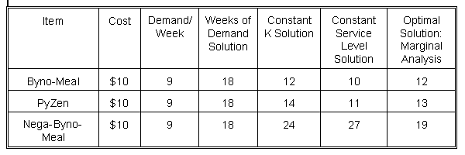
Why Bother?
WEEKS OF DEMAND SOLUTION Cost: $540
CONSTANT "K" SOLUTION Cost: $500
CONSTANT PROBABILITY SOLUTION Cost: $480
OPTIMAL SOLUTION Cost: $440

Slide 28
Effect of Differential Item Cost (Profit) on Stocking Methods
22 items in inventory, all with Poisson demand as shown
Desire a 90% service level (fill rate).
Item | Cost | Demand/Week | Typical Solution | Constant "K" Solution | Constant Probability | Optimal Solution
1 | $1000 | 1 | 2 | 2 | 2 | 0
2-11 | $100 | 1 | 2 | 2 | 2 | 2
12 | $1000 | 10 | 20 | 23 | 11 | 6
13-22 | $100 | 10 | 20 | 23 | 11 | 14

Slide 29
Solutions from Methods
Stock Two Week's Demand
  Service Level: 90% on items 1-11, 100% on items 12-22, overall near 100% Cost: $44,000
Constant “K” Solution
  Service Level: mean + 1.28*std.dev.,
  overall service near 100% Cost: $50,000
Constant Probability Problem
  Service Level: as close to 90% on each item as possible Cost: $26,000
Optimal Solution
  Service Level: roughly, 0% on item 1, 90% items 2-11, 60% items 12, 100% items 13-22, overall 92% Cost: $22,000

Slide 30
Marginal Analysis
Iteratively assign inventory to products. Where to assign 1st unit?
Item Number | Current Inventory | Cost | Expected Customers Served by Next Unit | Expected Number Served Per Dollar
1 | 0 | $1000 | 0.63 | 0.00063
2 | 0 | $100 | 0.63 | 0.0063
12 | 0 | $1000 | 0.99 | 0.00099
13 | 0 | $100 | 0.99 | 0.0099
Assign 1st unit to item 13

Slide 31
Where to assign 2nd unit?
Item Number | Current Inventory | Cost | Expected Customers Served by Next Unit | Expected Number Served Per Dollar
1 | 0 | $1000 | 0.63 | 0.00063
2 | 0 | $100 | 0.63 | 0.0063
12 | 0 | $1000 | 0.99 | 0.00099
13 | 1 | $100 | 1.97-.99=0.98 | 0.0098

Slide 32
Marginal Analysis
Where to assign 20th unit?
Item Number | Current Inventory | Cost | Expected Customers Served by Next Unit | Expected Number Served Per Dollar
1 | 0 | $1000 | 0.63 | 0.00063
2 | 1 | $100 | .89-.63=.26 | 0.0026
12 | 5 | $1000 | 5.88-4.95=.93 | 0.00093
13 | 13 | $100 | 9.79-9.66=.13 | 0.0013
Assign to item 2

Slide 33
Marginal Analysis
Where to assign 21st unit?
Item Number | Current Inventory | Cost | Expected Customers Served by Next Unit | Expected Number Served Per Dollar
1 | 0 | $1000 | 0.63 | 0.00063
2 | 2 | $100 | .98-.89=.09 | 0.00090
12 | 5 | $1000 | 5.88-4.95=.93 | 0.00093
13 | 13 | $100 | 9.79-9.66=.13 | 0.0013
Assign to item 13

Slide 34
Multiple Products with a Budget Constraint
"Get as much service as possible, but don't spend more than x on inventory”
Example: spend $22,000 on inventory for parts 1-22
Item Number | Cost | Demand/Day | Percent of Dem. | Const. K | Optimal
1 | $1000 | 1 | 1 | 1 | 0
2-11 | $100 | 1 | 1 | 1 | 2
12 | $1000 | 10 | 10 | 10 | 6
13-22 | $100 | 10 | 10 | 10 | 14
Constant K solution, where K=0
Service Levels: Percentage of Demand / Constant K = 83%
Marginal Analysis = 92%

Slide 35
Large Service Sector
Inventory Systems
Xerox, IBM
  Computer repair: $30 Billion in 1990
  Office equipment repair: $8 Billion in 1990
Xerox IBM
Spare Parts Inventory $4 Billion
Machine Types 100 1,000
Part Types 50,000 200,000
Service Engineers 15,000 13,500

Slide 36
Multi-Echelon Structure
Typical structure
  Central - 57% inventory value
  Middle - 7%
  Field - 36%
Xerox IBM (1989) IBM(1990's)
Central 2 2 1
Regional 5 21 5
District 74 64 90
Field 27,000 15,000 15,000

Slide 37
Centralized vs. Decentralized Inventory
Variance of large system is sum of variances of small systems
  Vcentral = Vfield_1 + Vfield_2 + …
    Example: 20 field units, each facing demand for a product characterized by normal distribution with mean of 50, variance of 100. 95% of cycles should not have a stock-out
  Decentralized
    For each field unit stock up to 50 + Square root (100) x 1.65 = 67 Total inventory in system: 20 x 67 = 1,340
  Centralized
    System mean: 20 x 50 = 1,000, System variance: 20 x 100 = 2,000, Stock 1,000 + Square root (2,000) x 1.65 = 1,074
Notes:
This material is actually in Chapter 3, but it may also be appropriate to teach in this session.

Slide 38
Practical Methods to Reduce Stockouts, Shrinkage, and Inventory Inaccuracy
Revenue Sharing
Markdown Money
Phantom Stockouts
Inventory Inaccuracy
Shrinkage

Slide 39
Chapter Summary
Opportunity Knocks! Why?
  Improvements in technology and logistics
  lack of inventory system response
Stocking decisions
  ANY system is better than "gut feel"
  You get what you pay for

